Slide 1
Automated Payment Scheduler using XDC Blockchain
Presented by – Abhishek Raj
M.TECH
VIT VELLORE

Slide 2
Goal: Minimize delays and disputes in global shipping logistics.
A smart agent that automates milestone-based payments for trade finance deals using:
AI for scheduling
Oracle for verification
XDC smart contracts

Slide 3
The Problem
Trade finance deals often suffer from:
Delayed payments
Disputes over delivery
Manual verification issues

Slide 4
System Overview
Agent Components:
✅ Embedded Wallet (XDC test)
🔄 Smart Contract Simulation
🛰 Oracle Delivery Verification
⏱ Payment Scheduler AI Agent

Slide 5
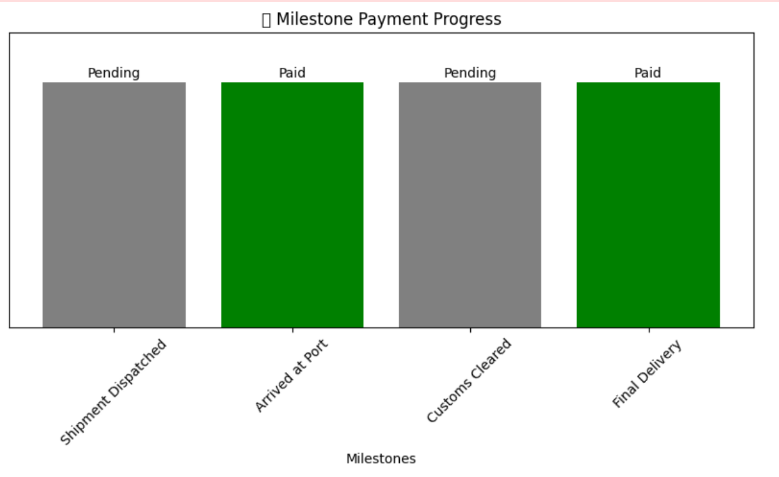

Slide 6
Technology Stack
Python (Jupyter Notebook)
XDC (XinFin) Blockchain Simulated
Smart contract logic (simulated)
Oracle-based delivery verification
AI scheduling logic

Slide 7
Embedded Wallet
Simulated creation using eth account.
Auto-generates:
🔐 Private Key
📬 Public Address
💰 Simulated balance (e.g., 10,000 XDC)

Slide 8
Oracle Verification System
80% chance to verify successful milestone
Mimics real-world APIs like port authorities or IoT feeds
Simulates delivery verification using:

Slide 9
Payment Scheduler Agent
Schedules 4 milestone events:
Shipment Dispatched
Arrived at Port
Customs Cleared
Final Delivery

Slide 10
Live Demo Output
🎯 Embedded Wallet Created
🔐 Private Key (simulated): 0x47ba37cb8dd8ef9b626056a27b1fb349d473c68f428fd75174d747cd1cae93a7
📬 Public Address: 0x20e6aAe87BE9344f5aA7831DB23fB8e50B3eb965
💰 Simulated Balance: 10000 XDC
Smart Contract: Deal DEAL001 created with milestones.
⏳ Waiting for milestone: Shipment Dispatched (scheduled at 2025-05-29 15:39:33.029314)
❌ Milestone 'Shipment Dispatched' verification failed. No payment triggered.
⏳ Waiting for milestone: Arrived at Port (scheduled at 2025-05-29 15:39:35.029314)
📦 Milestone 'Arrived at Port' verified by Oracle.
✅ Payment triggered for milestone: Arrived at Port in deal DEAL001
⏳ Waiting for milestone: Customs Cleared (scheduled at 2025-05-29 15:39:37.029314)
❌ Milestone 'Customs Cleared' verification failed. No payment triggered.
⏳ Waiting for milestone: Final Delivery (scheduled at 2025-05-29 15:39:39.029314)
📦 Milestone 'Final Delivery' verified by Oracle.
✅ Payment triggered for milestone: Final Delivery in deal DEAL001

Slide 11
Conclusion
On-chain contract deployment on XDC testnet
Integration with real shipment APIs
Dashboard + Notification alerts
Multi-party deal signing via smart contracts
This project shows how AI + Blockchain can automate complex financial flows with transparency and trust.

Slide 12
REFERENCES
Jurafsky, D., & Martin, J. H. (2021). Speech and Language Processing (3rd ed.).
https://web.stanford.edu/~jurafsky/slp3/
XinFin. (n.d.). XDC Network – Hybrid Blockchain for Global Trade and Finance.
https://www.xdc.org/
Ethereum Foundation. (n.d.). eth-account Documentation.
https://eth-account.readthedocs.io/en/stable/

